Slide 1


DEPARTMENT OF COMPUTER ENGINEERING
Title: AceIt- An Interview Preparation Platform
Student name: Saurabh Yadav
Student name: Sahil Sajwan
Student name: Ashneel Raje
Student name: Samradnyee Shinde
Under the Guidance of Dr. P.P.ADIVAREKAR

Slide 2
Overview
1. Problem Statement
2. Objectives
3. Architecture Diagram
4. UML Diagrams
4.1. Data Flow Diagram
4.2. Use Case Diagram
4.3. Sequence Diagram
4.4. Activity Diagram
5. Flow of Modules
6. Technology Stack
7. Implementation
8. Conclusion

Slide 3
1. Problem Statement
Along with getting good grades, it is also important for students to perform well in interviews to get a job in their dream companies. To do so, it is important for them to prepare with strong overall knowledge and refer to the right resources. Nowadays due to the abundance of resources it is very difficult to find the best resources that will help students prepare for interviews in a minimum time span. They are also not fully informed of the type of requirements for each company. To tackle these problems and provide features which solve these issues all on one platform, we propose to create ACEit- An Interview Preparation Platform.

Slide 4
2.Objectives
Our objective is to minimize their problems by solving the time consuming problems and give them the best resources available in the market so they can prepare well. Users can read notes, do courses, view videos and take tests to assess themselves.
With the help of this platform students will get all the best resources at a single destination and they will also be able to assess themselves by attempting topic-wise tests.
The Quiz Analysis feature will analyze their performance and provide useful statistics so they are aware of which subject areas they need to improve on.
The Interview Guide will provide information of all top companies and their specific requirements, hence helping them set a goal and working towards fulfilling it.
The Community feature will enable them to interact with seniors and fellow students and hence will aid in resolving their doubts.

Slide 5
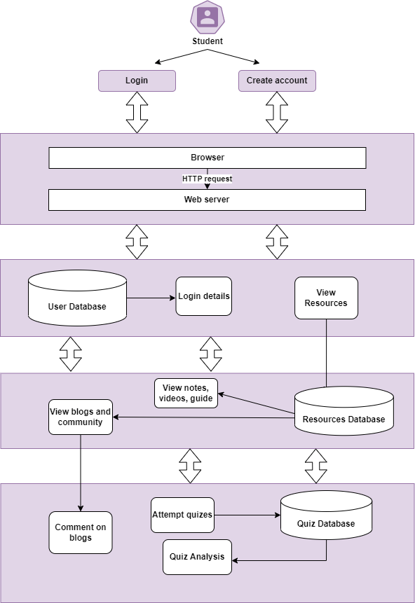
3. Architecture Diagram

Slide 6
4. UML Diagrams
4.1. Data Flow Diagram
4.2. Use Case Diagram
4.3. Sequence Diagram
4.4. Activity Diagram

Slide 7
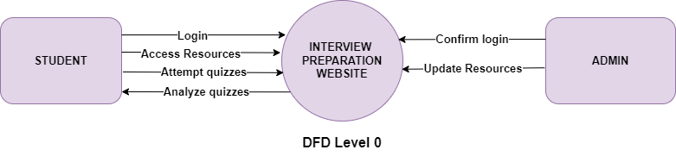
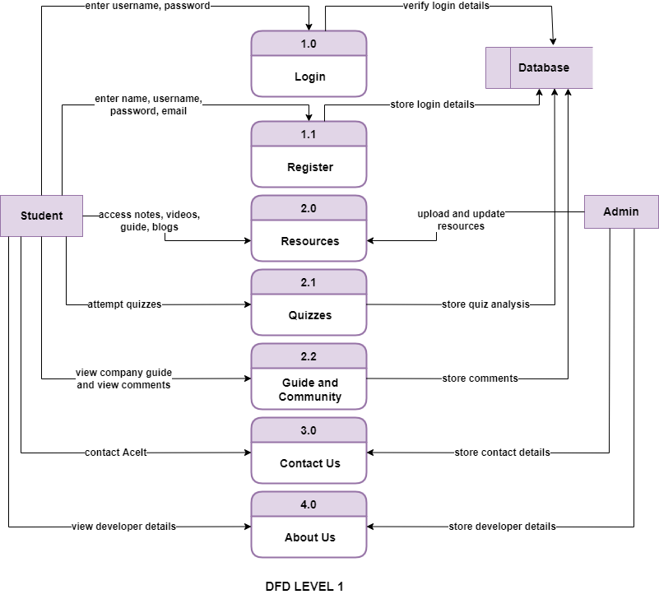
4.1. Data Flow Diagram
Data Flow Diagram is a basic overview of the whole system or process being analyzed or modeled. It's designed to be an at-a-glance view, showing the system as a single high-level process, with its relationship to external entities.

Slide 8
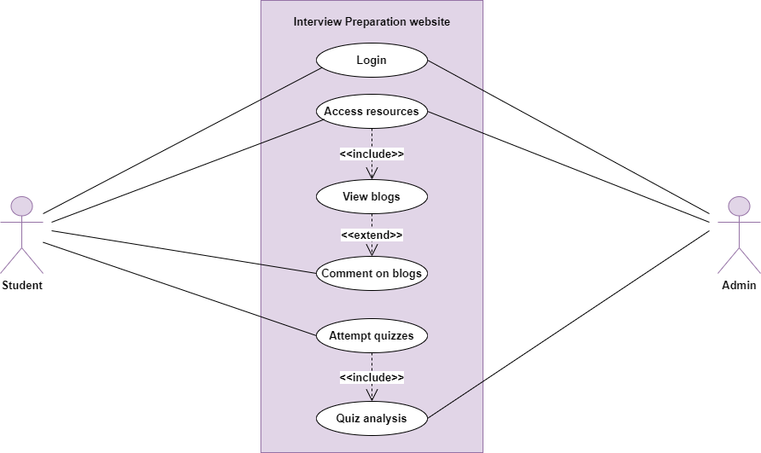
4.2. Use Case
A use case diagram is a graphical depiction of a user's possible interactions with a system. It shows various use cases and different types of users the system has. The use cases are represented by either circles or ellipses.

Slide 9
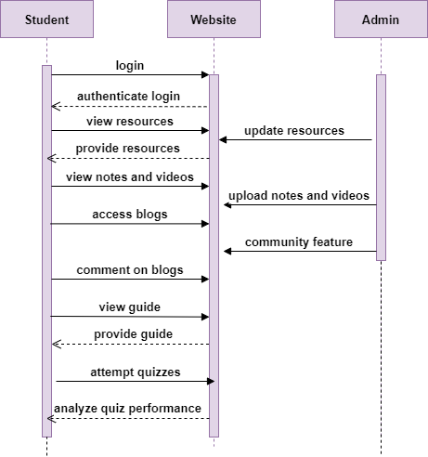
4.3. Sequence Diagram
A sequence diagram shows process interactions arranged in time sequence of the project. It depicts the processes involved and the sequence of messages exchanged between the processes needed to carry out the functionality.

Slide 10
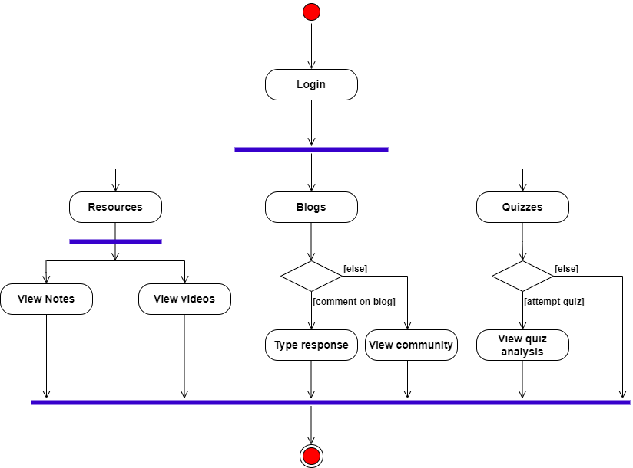
4.4. Activity Diagram
An activity diagram visually presents a series of actions or flow of control in a system similar to a flowchart or a data flow diagram. Activity diagrams are often used in business process modeling. They can also describe the steps in a use case diagram.

Slide 11
5. List Of Modules
The modules included are:
Home page
Login page
Resources
3.1 Notes
3.2 Videos
3.3 Blogs
3.4 Interview Guide
Quizzes
Contact us
6. About us

Slide 12
6. Technology Stack
The technologies used for implementing this project are:
HTML5
CSS
JavaScript
Django
Bootstrap
Flask
Plotly

Slide 13
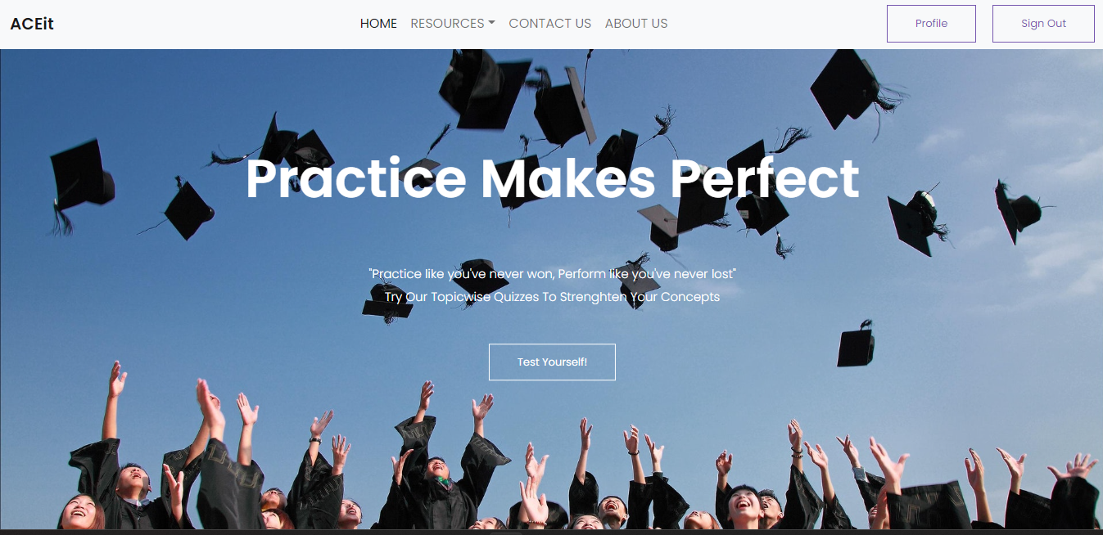
7. Implementation
Home Page

Slide 14
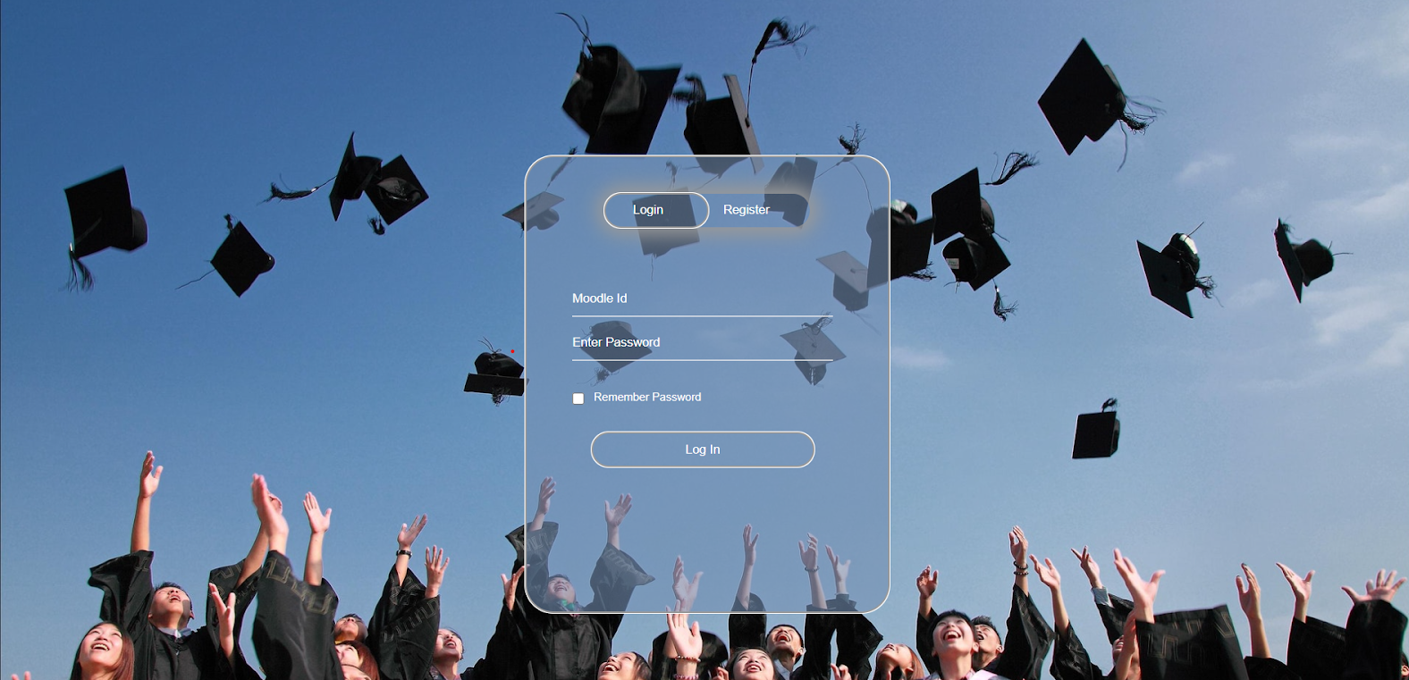
Login Page

Slide 15
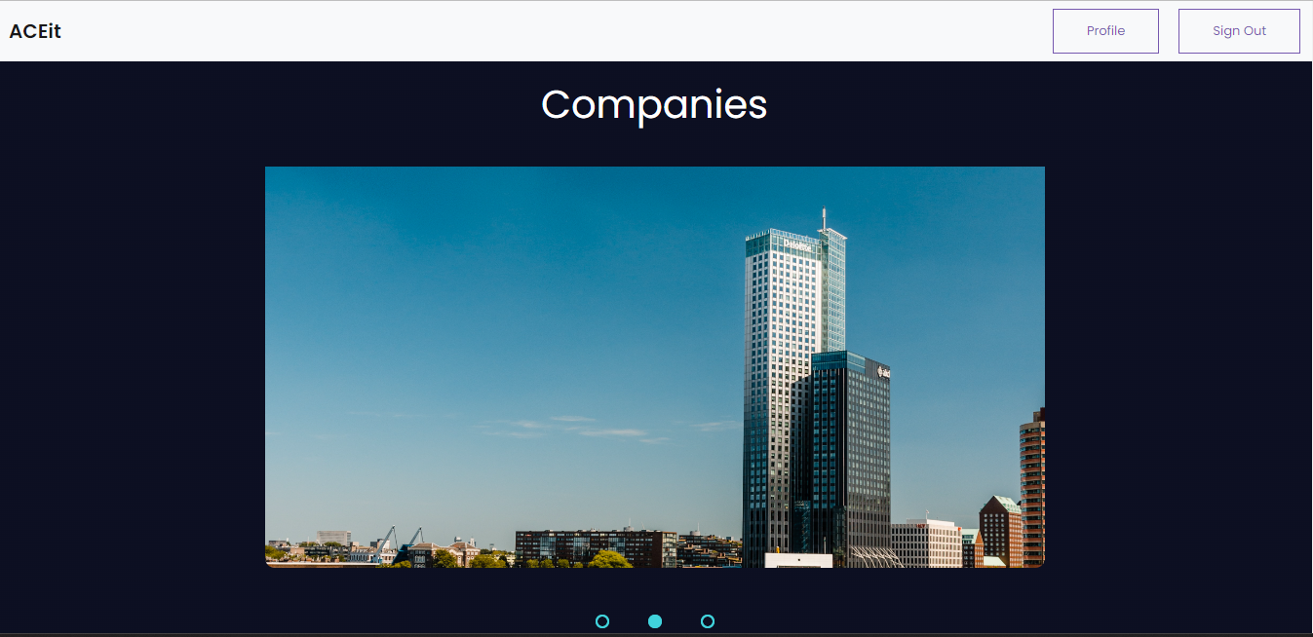
Companies

Slide 16
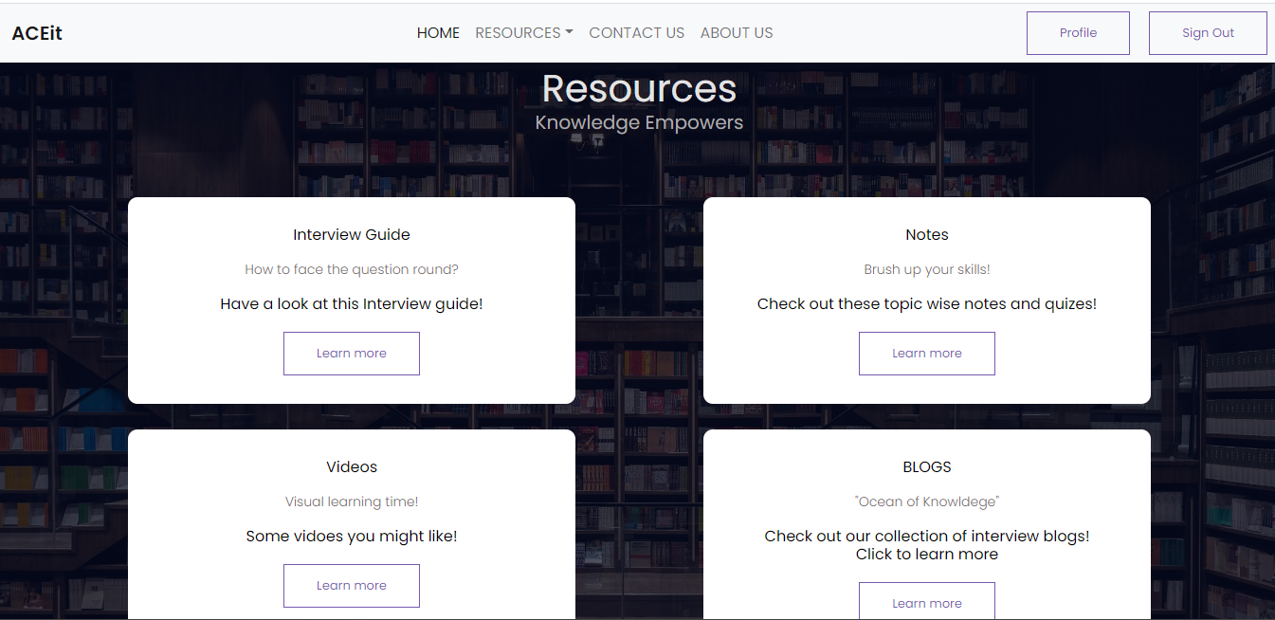
Resources

Slide 17
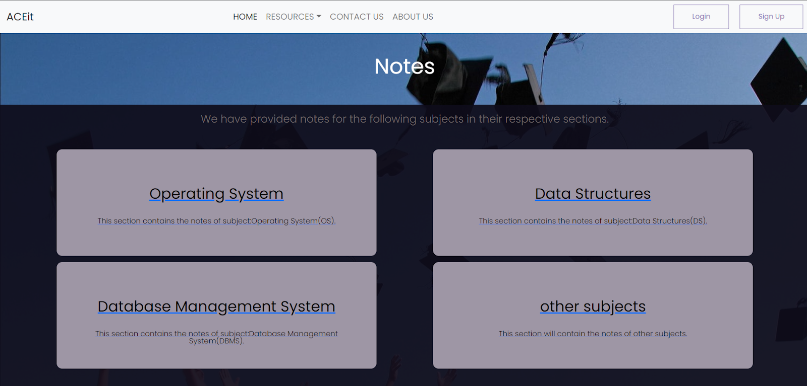
Notes Page

Slide 18
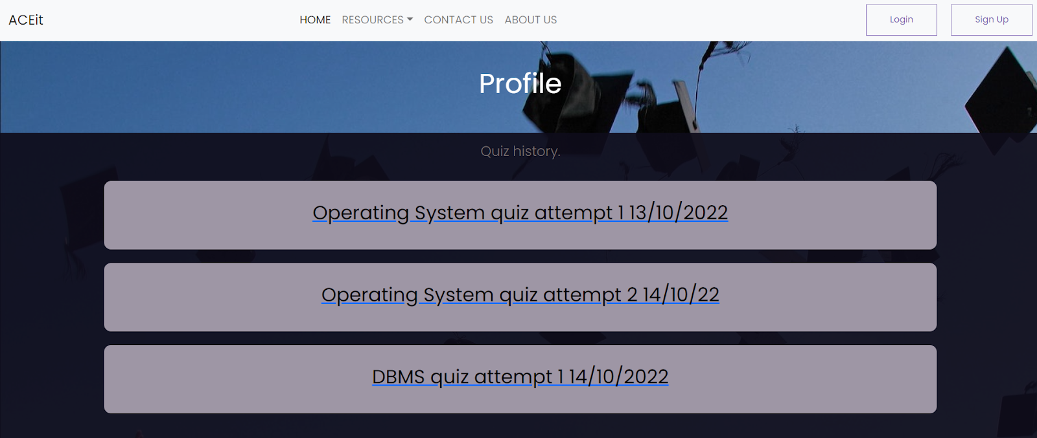
Profile Page

Slide 19
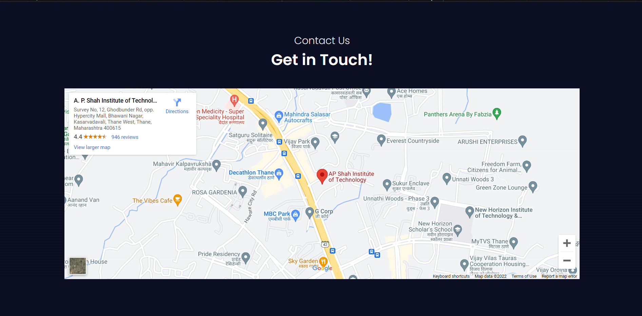
Contact Us

Slide 20
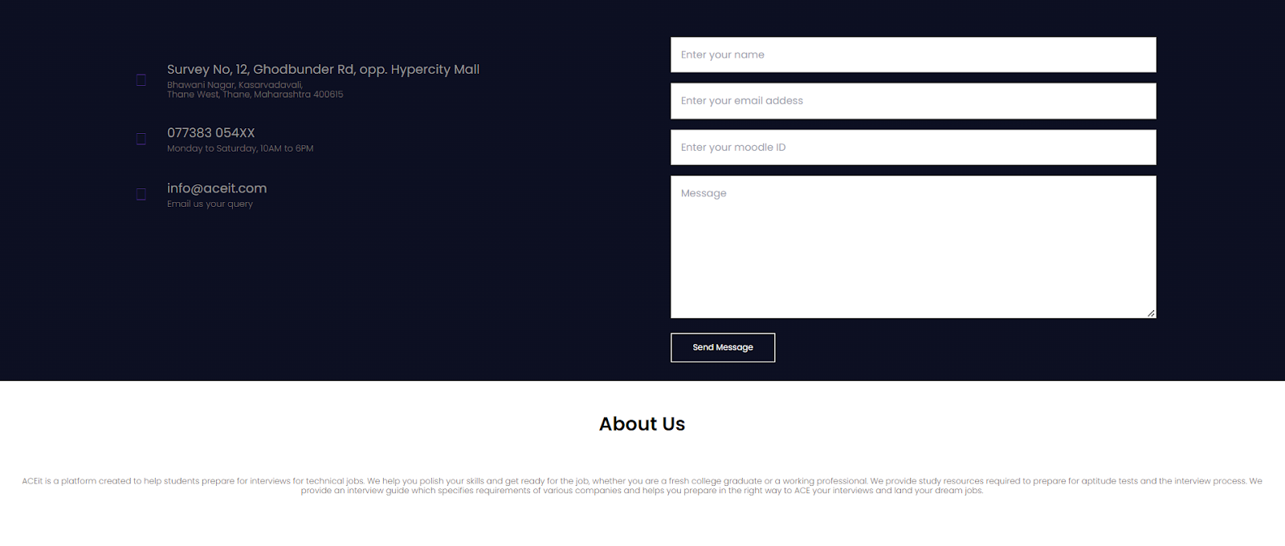
About Us

Slide 21
8. Conclusion
To conclude, we see that we have created a website ACEit which is an interview Preparation Portal for students and aspiring candidates who want to prepare for their job interviews.
ACEit aims at aiding students through this preparation process by providing everything from notes, video links, blogs, interview guides, quizzes for practice and their performance analysis too.
This website has the sole goal of being a one stop destination for students looking to prepare for their technical interviews after graduation.
ACEit has a user-friendly interface which the students can easily navigate and access all the resources provided.
Hence, ACEit is an effective tool which will help students to ace their job interviews and land their dream jobs.

Slide 22
Thank You!

